Slide 1
Dengue Forecasting Using Machine Learning Method
Joy Barai (ID - 2018-1-60-011)
Maleha Israt Chowdhury (ID - 2018-1-60-015)
Kamarum Monira Mow (ID - 2018-1-60-016)

Slide 2

Overview
Motivation
Aim and Objective
Dataset
Methodology
Model Evaluation
Result and Analysis
Conclusion

Slide 3
Source: The Centers for Disease Control
400,000,000
people are infected yearly

Slide 4

Why should I care ?
One half of the world population is predicted to be affected in 2080.
Source: "The current and future global distribution and population at risk of dengue." Published: 10 June 2019

Slide 5

Motivation
The primary motivation of this project is to handle the continuous data with several decisions in such a severe problem like dengue forecasting.

Slide 6

Aim and Objective
A dengue early warning system aims to prevent a dengue outbreak by providing an accurate prediction of a rise in dengue cases and sufficient time to allow timely decisions and preventive measures to be taken by local authorities.

Slide 7

Dataset
A dataset named “Dengue Cases and Metrological ” has been used.
It consists with dengue related and weather related data.
There are total 24 features with a sample size of 1456 records.
It has been taken from Drivendata and the source link is- https://www.drivendata.org/competitions/44/dengai-predicting-disease-spread/

Slide 8

Dengue Surveillance Project Data
Feature
24
(Continuous)
Time Frame
1999-2008(San Juan)
Records- 936
2000-2010(Iquitos)
Records- 520

Slide 9

About Dataset
Feature
24
Main Feature
Location
Temperature
Precipitation
Humidity
Vegetation Index

Slide 10

Pre-Processing
Checking null entries
Convert Temperature Kelvin to Celsius
Rounding every value up to 3 decimal places
Combining data where necessary
Applying feature scaling

Slide 11
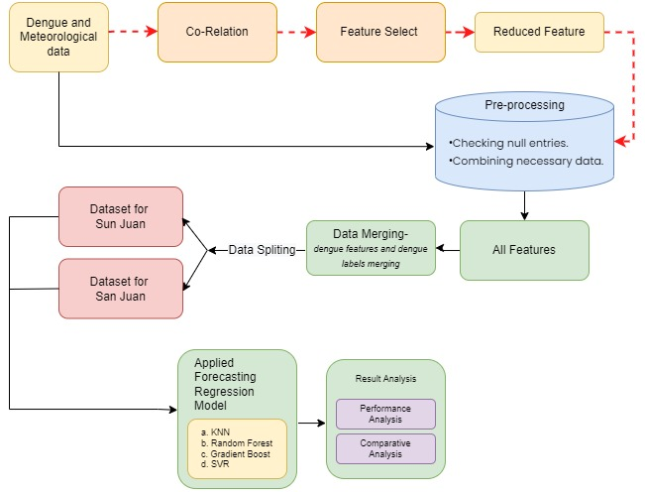
Methodology

Slide 12
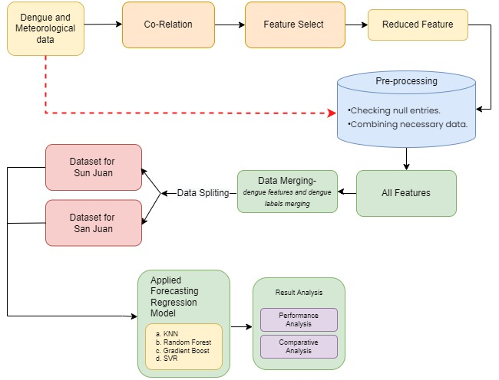
Methodology

Slide 13
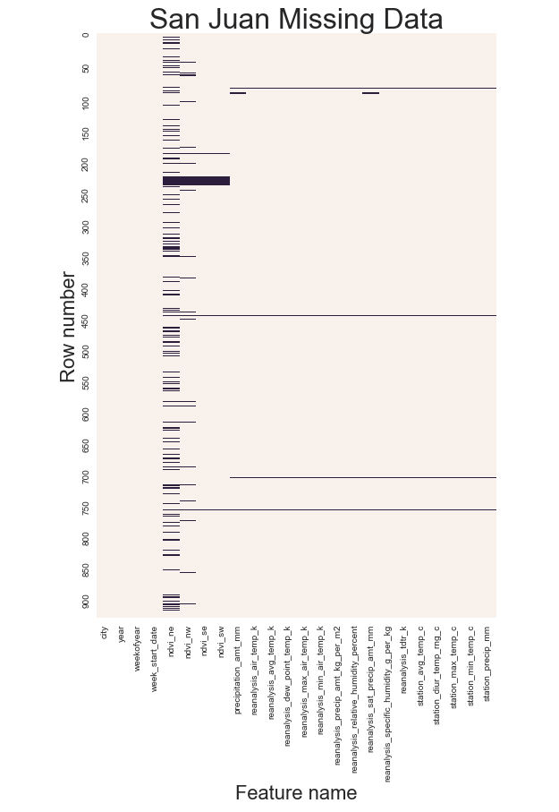
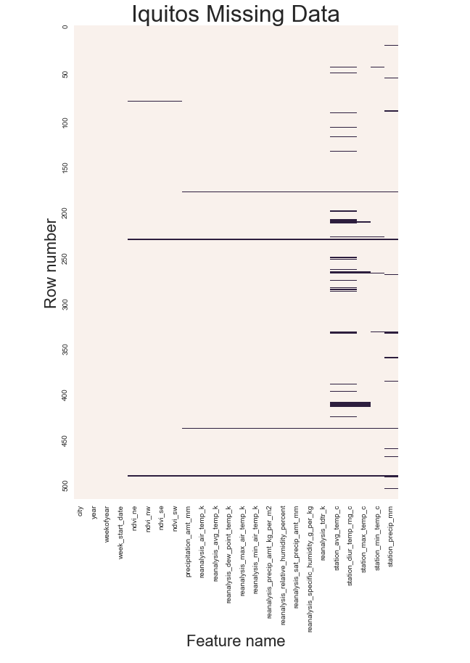
Data Cleaning & Analysis
features constituted by missing values.
Missing samples in different data.
Missing data filled using Mean Method.

Slide 14
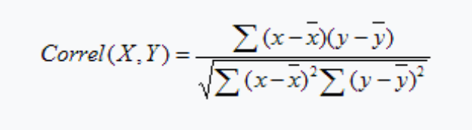
Correlation
The CORREL function is categorized under Excel Statistical functions. It will calculate the correlation coefficient between two variables.
The formula is-
We applied this on our dataset between different attributes vs Total Cases.
Then we sort the data as highly co relatable to low.
We deducted the negative values after co relation.
Minimal positive values are also deducted.
Finally, in San Juan the features remain in number 11 from 16 and In case of Iquitos there were 8 out of 16.

Slide 15
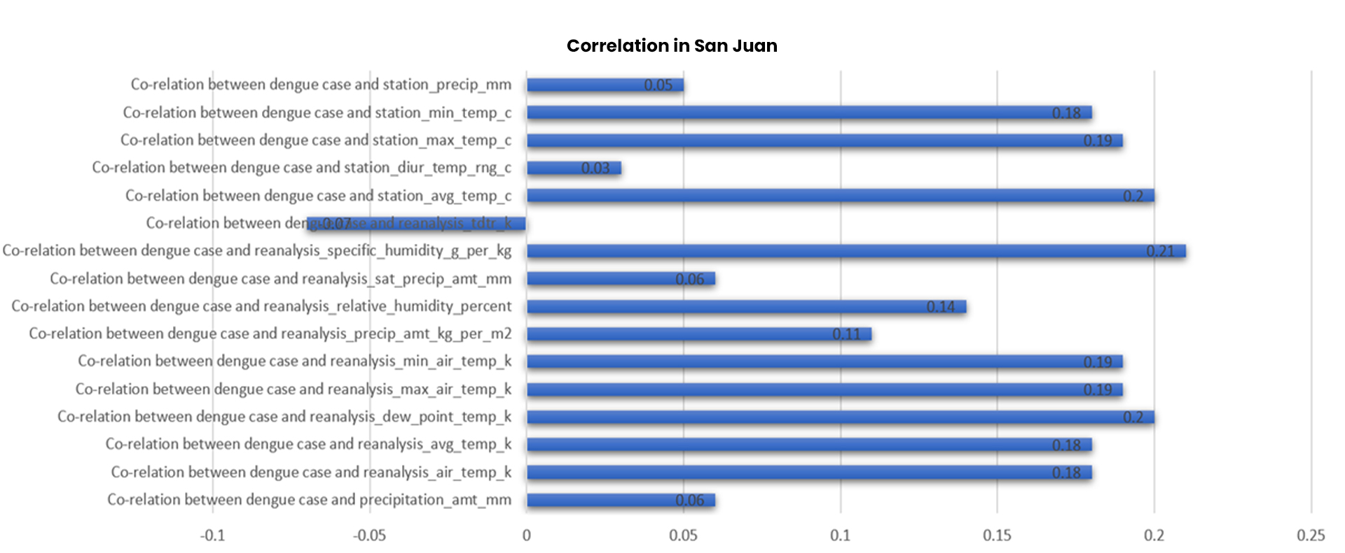
Visualization of the co relations

Slide 16
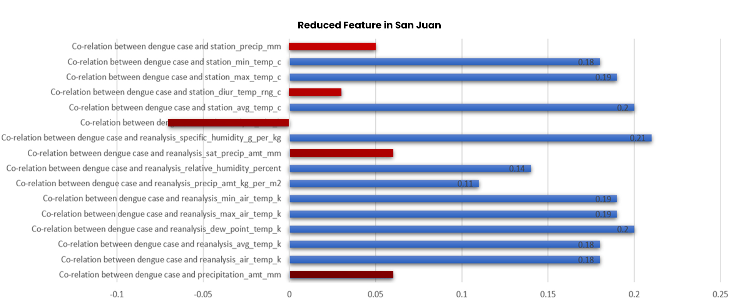

Slide 17
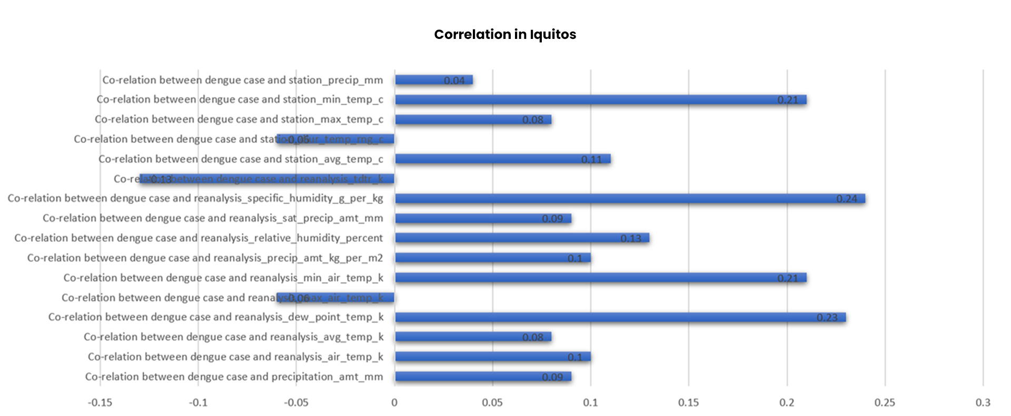
Visualization of the co relations

Slide 18
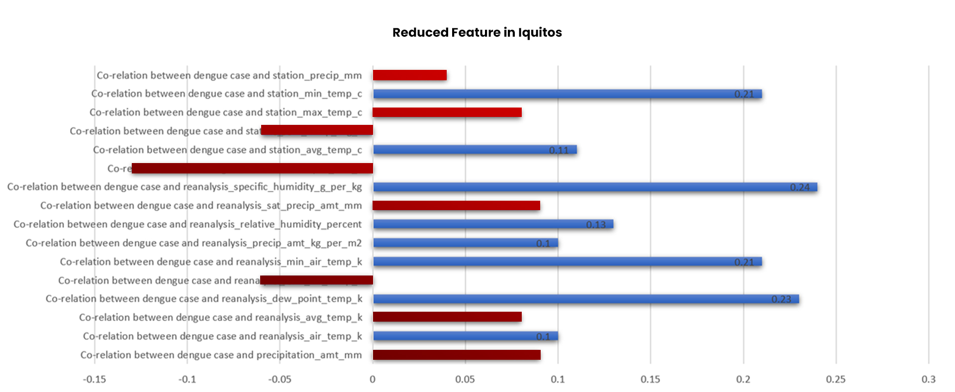

Slide 19
Feature Selection
City
Total Number of Features
Number of selected Features
San Juan
16
11
Iquitos
16
8

Slide 20
Implemented Machine Learning Model
K-Nearest Neighbor (KNN)
Random Forest (RF)
Gradient Boost Regression (GBR)
Support Vector Regression(SVR)

Slide 21
K-Nearest Neighbor (KNN)
KNN algorithm can be used for both classification and regression problems. The KNN algorithm uses ‘feature similarity’ to predict the values of any new data points. This means that the new point is assigned a value based on how closely it resembles the points in the training set.

Slide 22
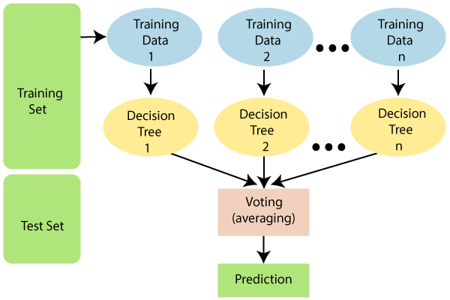
Random Forest (RF)
Random forests or random decision forests are an ensemble learning method for classification, regression and other tasks that operates by constructing a multitude of decision trees at training time.

Slide 23
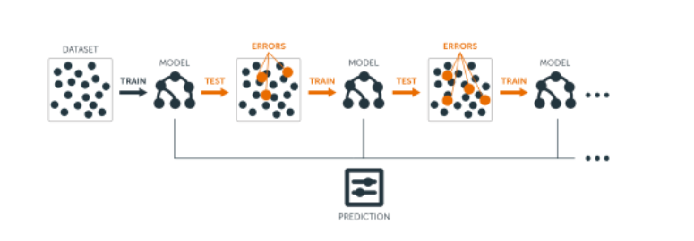
Gradient Boosting Regression (GBR)
Gradient boosting is a machine learning technique used in regression and classification tasks, among others. It gives a prediction model in the form of an ensemble of weak prediction models, which are typically decision trees.

Slide 24
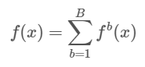
Gradient Boosting Regression (GBR)
The basic algorithm for boosted regression trees can be generalized to the following where the final model is simply a stagewise additive model of b individual regression trees.

Slide 25
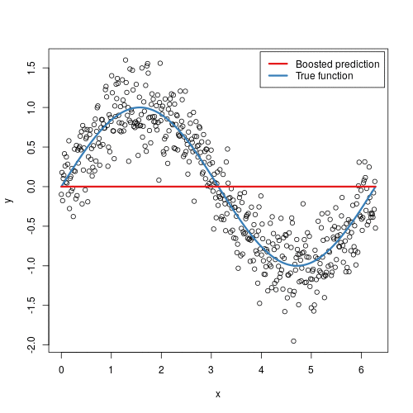
Gradient Boosting Regression (GBR)
Fig : Boosted regression tree predictions (courtesy of [Brandon Greenwell]

Slide 26
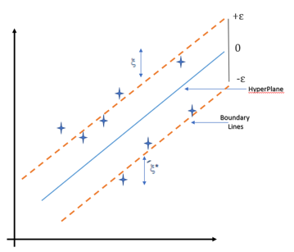
Support Vector Regression(SVR)
In machine learning, support-vector machines (SVMs, also support-vector networks) are supervised learning models with associated learning algorithms that analyze data for classification and regression analysis.

Slide 27
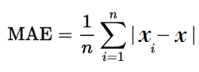
Evaluation
Mean Absolute Error

Slide 28
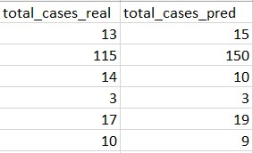
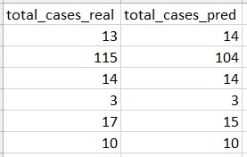
Applying K-Nearest Neighbor (KNN)
City - San Juan
Before Correlation After Correlation

Slide 29
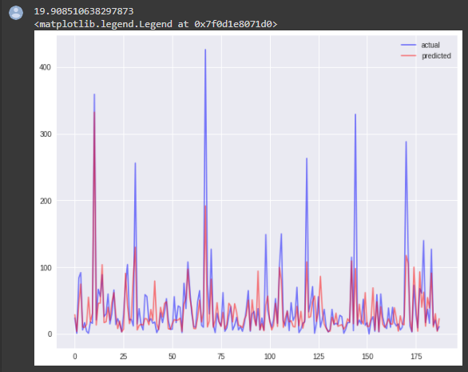
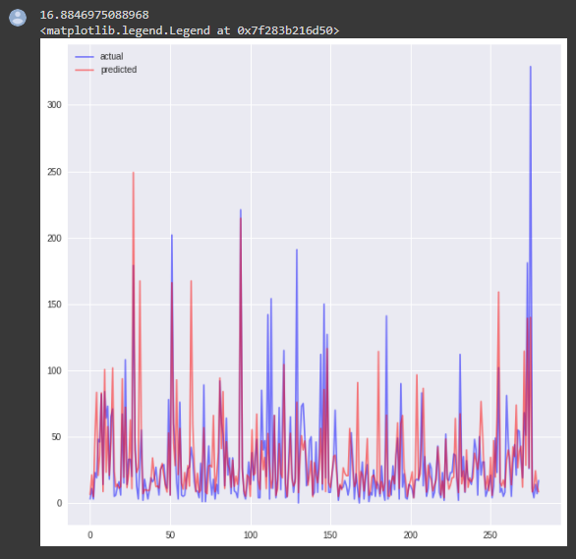
Applying K-Nearest Neighbor (KNN)
Before co-relation San Juan (KNN)
After co-relation San Juan (KNN)

Slide 30
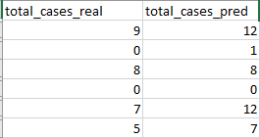
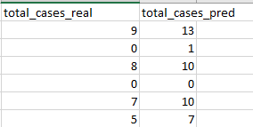
Applying K-Nearest Neighbor (KNN)
City - Iquitos
Before Correlation After Correlation

Slide 31
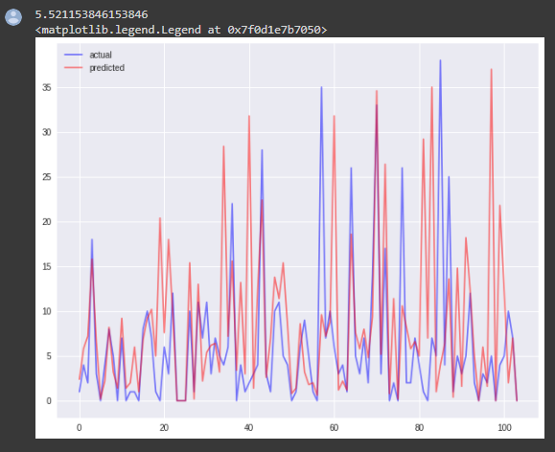
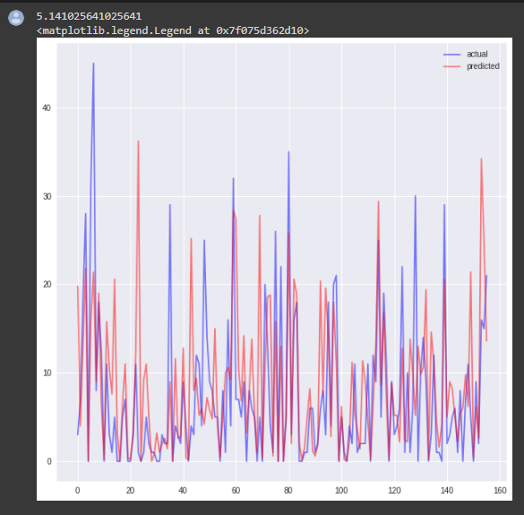
Applying K-Nearest Neighbor (KNN)
Before co-relation Iquitos (KNN)
After co-relation Iquitos (KNN)

Slide 32
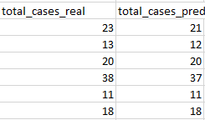
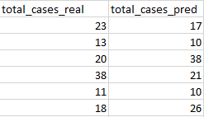
Applying Random Forest (RF)
City - San Juan
Before Correlation After Correlation

Slide 33
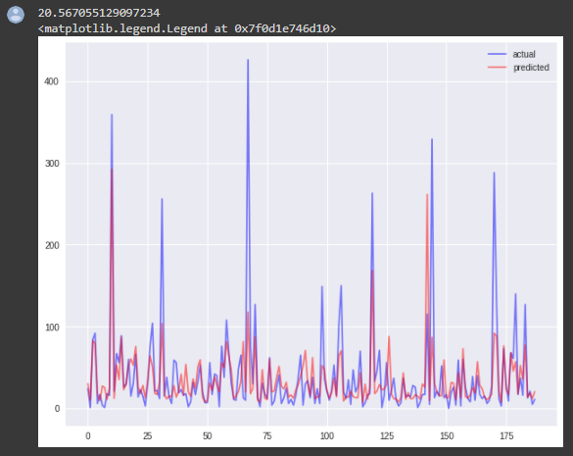
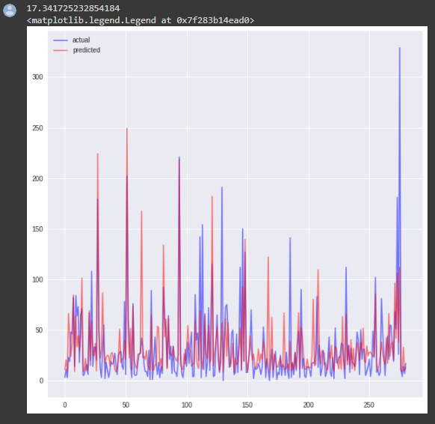
Applying Random Forest (RF)
Before co-relation San Juan (RF)
After co-relation San Juan (RF)

Slide 34
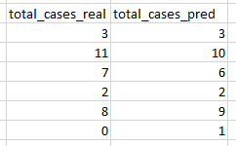
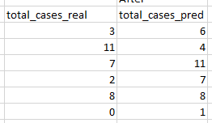
Applying Random Forest (RF)
City - Iquitos
Before Correlation After Correlation

Slide 35
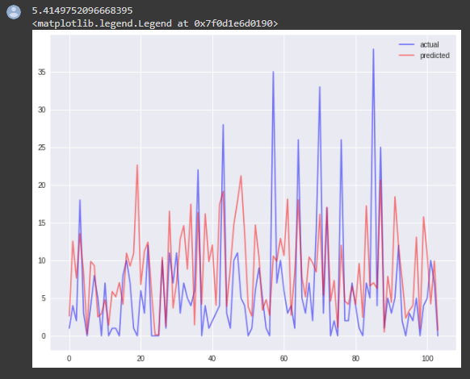
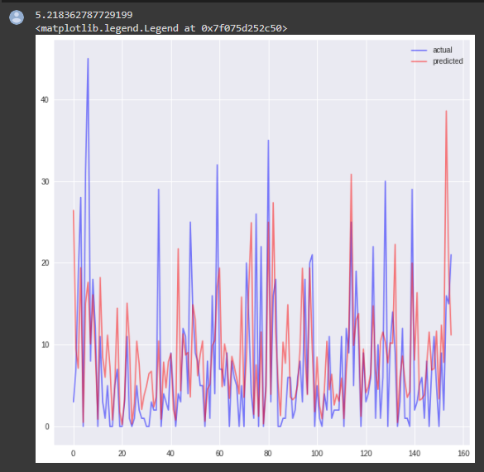
Applying Random Forest (RF)
Before co-relation Iquitos (RF)
After co-relation Iquitos (RF)

Slide 36
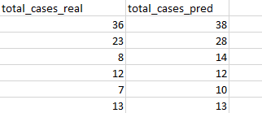
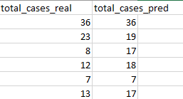
Applying Gradient Boosting Regression (GBR)
City - San Juan
Before Correlation After Correlation

Slide 37
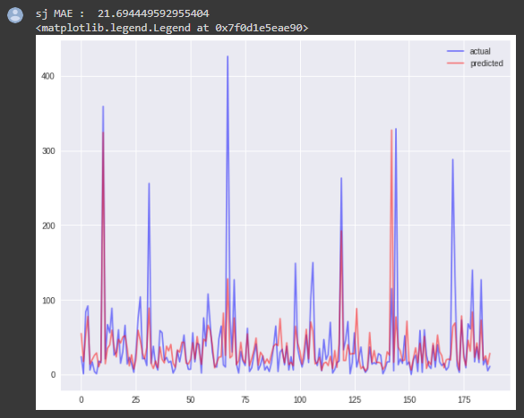
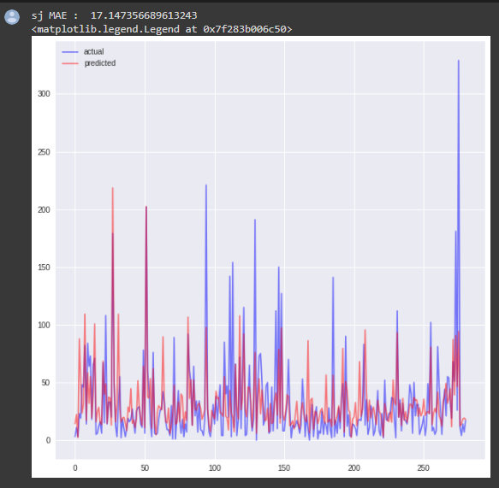
Applying Gradient Boosting Regression (GBR)
Before co-relation San Juan (GBR)
After co-relation San Juan (GBR)

Slide 38
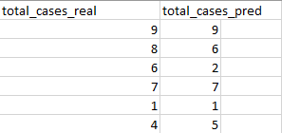
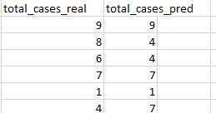
Applying Gradient Boosting Regression (GBR)
City - Iquitos
Before Correlation After Correlation

Slide 39
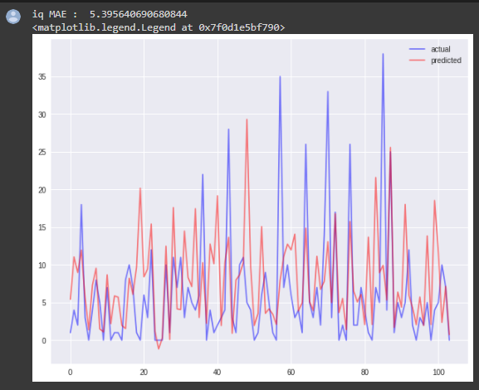
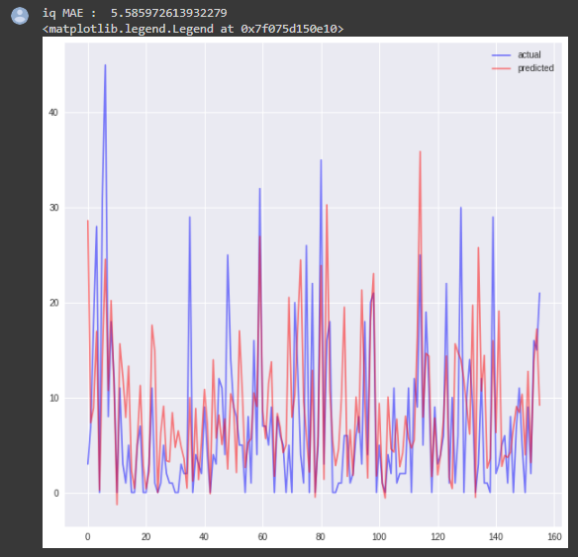
Applying Gradient Boosting Regression (GBR)
Before co-relation Iquitos (GBR)
After co-relation Iquitos (GBR)

Slide 40
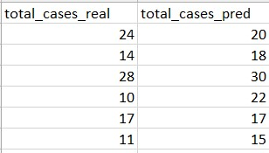
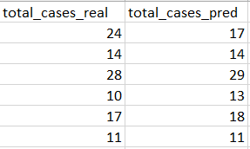
Applying Support Vector Regression(SVR)
City - San Juan
Before Correlation After Correlation

Slide 41
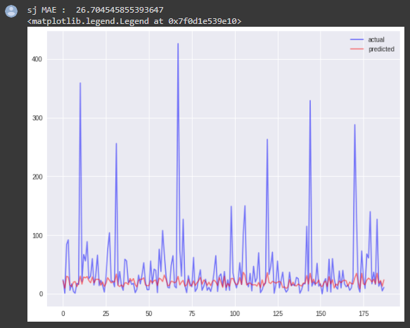
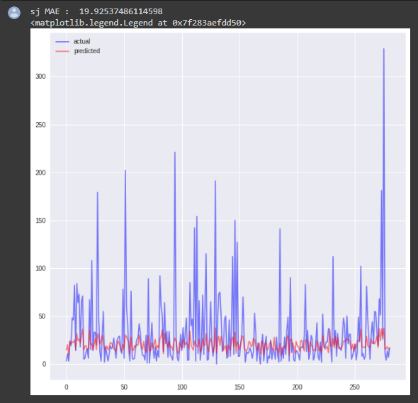
Applying Support Vector Regression(SVR)
Before co-relation San Juan (SVR)
After co-relation San Juan (SVR)

Slide 42
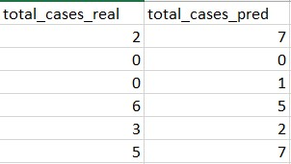
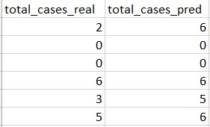
Applying Support Vector Regression(SVR)
City - Iquitos
Before Correlation After Correlation

Slide 43
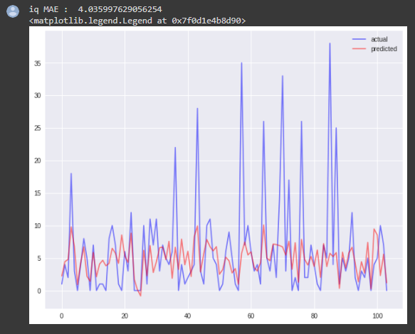
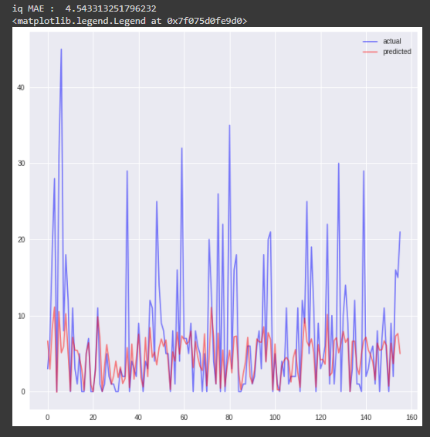
Applying Support Vector Regression(SVR)
Before co-relation Iquitos (SVR)
After co-relation Iquitos (SVR)

Slide 44
Result Analysis (MAE)
Model | San Juan | Iquitos
KNN | 19.90 | 5.52
RF | 20.56 | 5.41
GBR | 21.69 | 5.39
SVR | 26.70 | 4.03
Before Correlation
After Correlation
Model | San Juan | Iquitos
KNN | 16.88 | 5.14
RF | 17.34 | 5.21
GBR | 17.14 | 5.58
SVR | 19.92 | 4.54

Slide 45
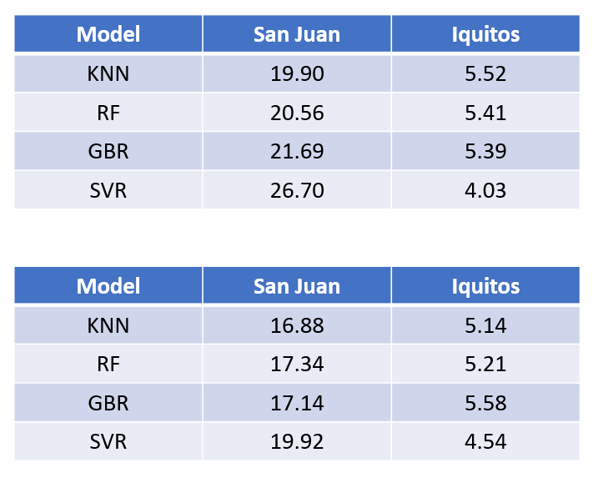
From these 4 Models, KNN is giving the best result.

Slide 46
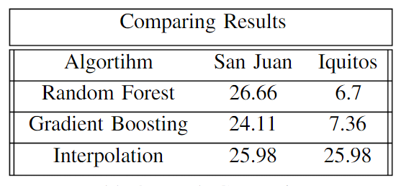
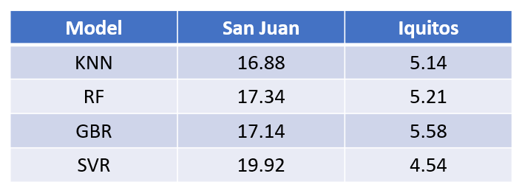
Table – Result of “Predicting Dengue Spread in San Juan and Iquitos*
Result Comparison
Table – Result of our prediction
* Singh, C., & Anuranjan. (n.d.). Predicting Dengue Spread in San Juan and Iquitos using Machine Learning. https://www.researchgate.net/publication/339473958_Predicting_Dengue_Spread_in_San_Juan_and_Iquitos_using_Machine_Learning

Slide 47

Limitations
Because of the continuous dataset we only use Regression, otherwise we could apply Classification too.

Slide 48

Future Work
The target can be increased with collaboration with more organizations and more Machine Learning techniques could be applied to gain a more accurate prediction
These result can further be developed by using models that are known to work better for Time Series based data like the ARIMA model.

Slide 49


